Slide 1
BIOS27816: Population biology of infectious diseases of global health concern
Nutrition, immunity, and poverty in the control of infectious diseases
UChicago Center in Paris
Paris, France
January 2024

Slide 2
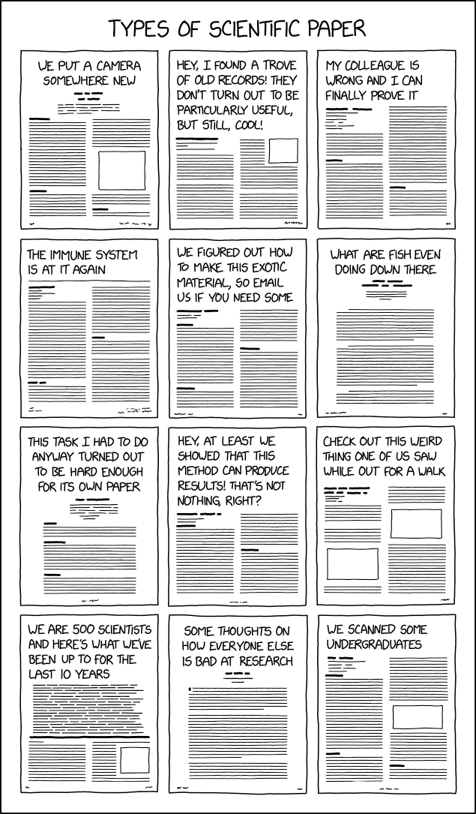

Slide 4
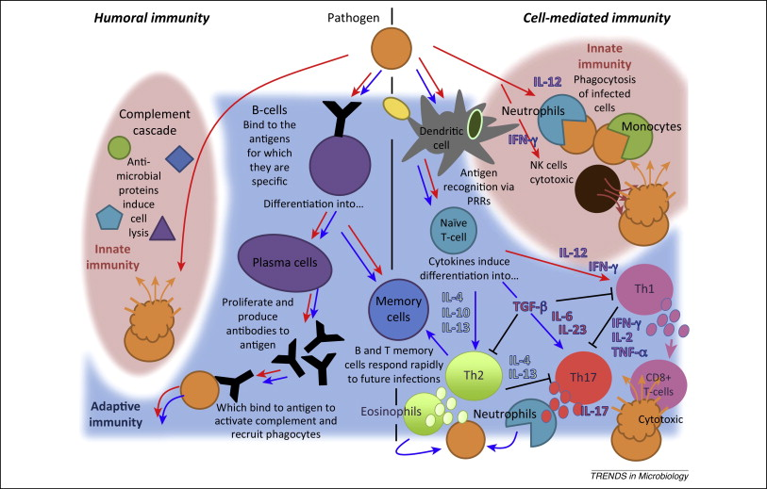
Basic Overview of the Immune System
Brook and Dobson 2015.

Slide 5
Basic Overview of the Immune System
Surface Barriers -skin
-mucous membranes
-secretions
Cell-Mediated Adaptive Immunity
- T cells
Nonspecific Defense
(Innate Immunity)
Specific Defense (Acquired/ Adaptive Immunity)
Innate Cellular Immunity
-NK cells
-monocytes
-neutrophils
Innate Humoral Immunity
-complement cascade
Humoral Adaptive Immunity
- Plasma cells and antibodies

Slide 6
Basic COVID Immune Response

Slide 8
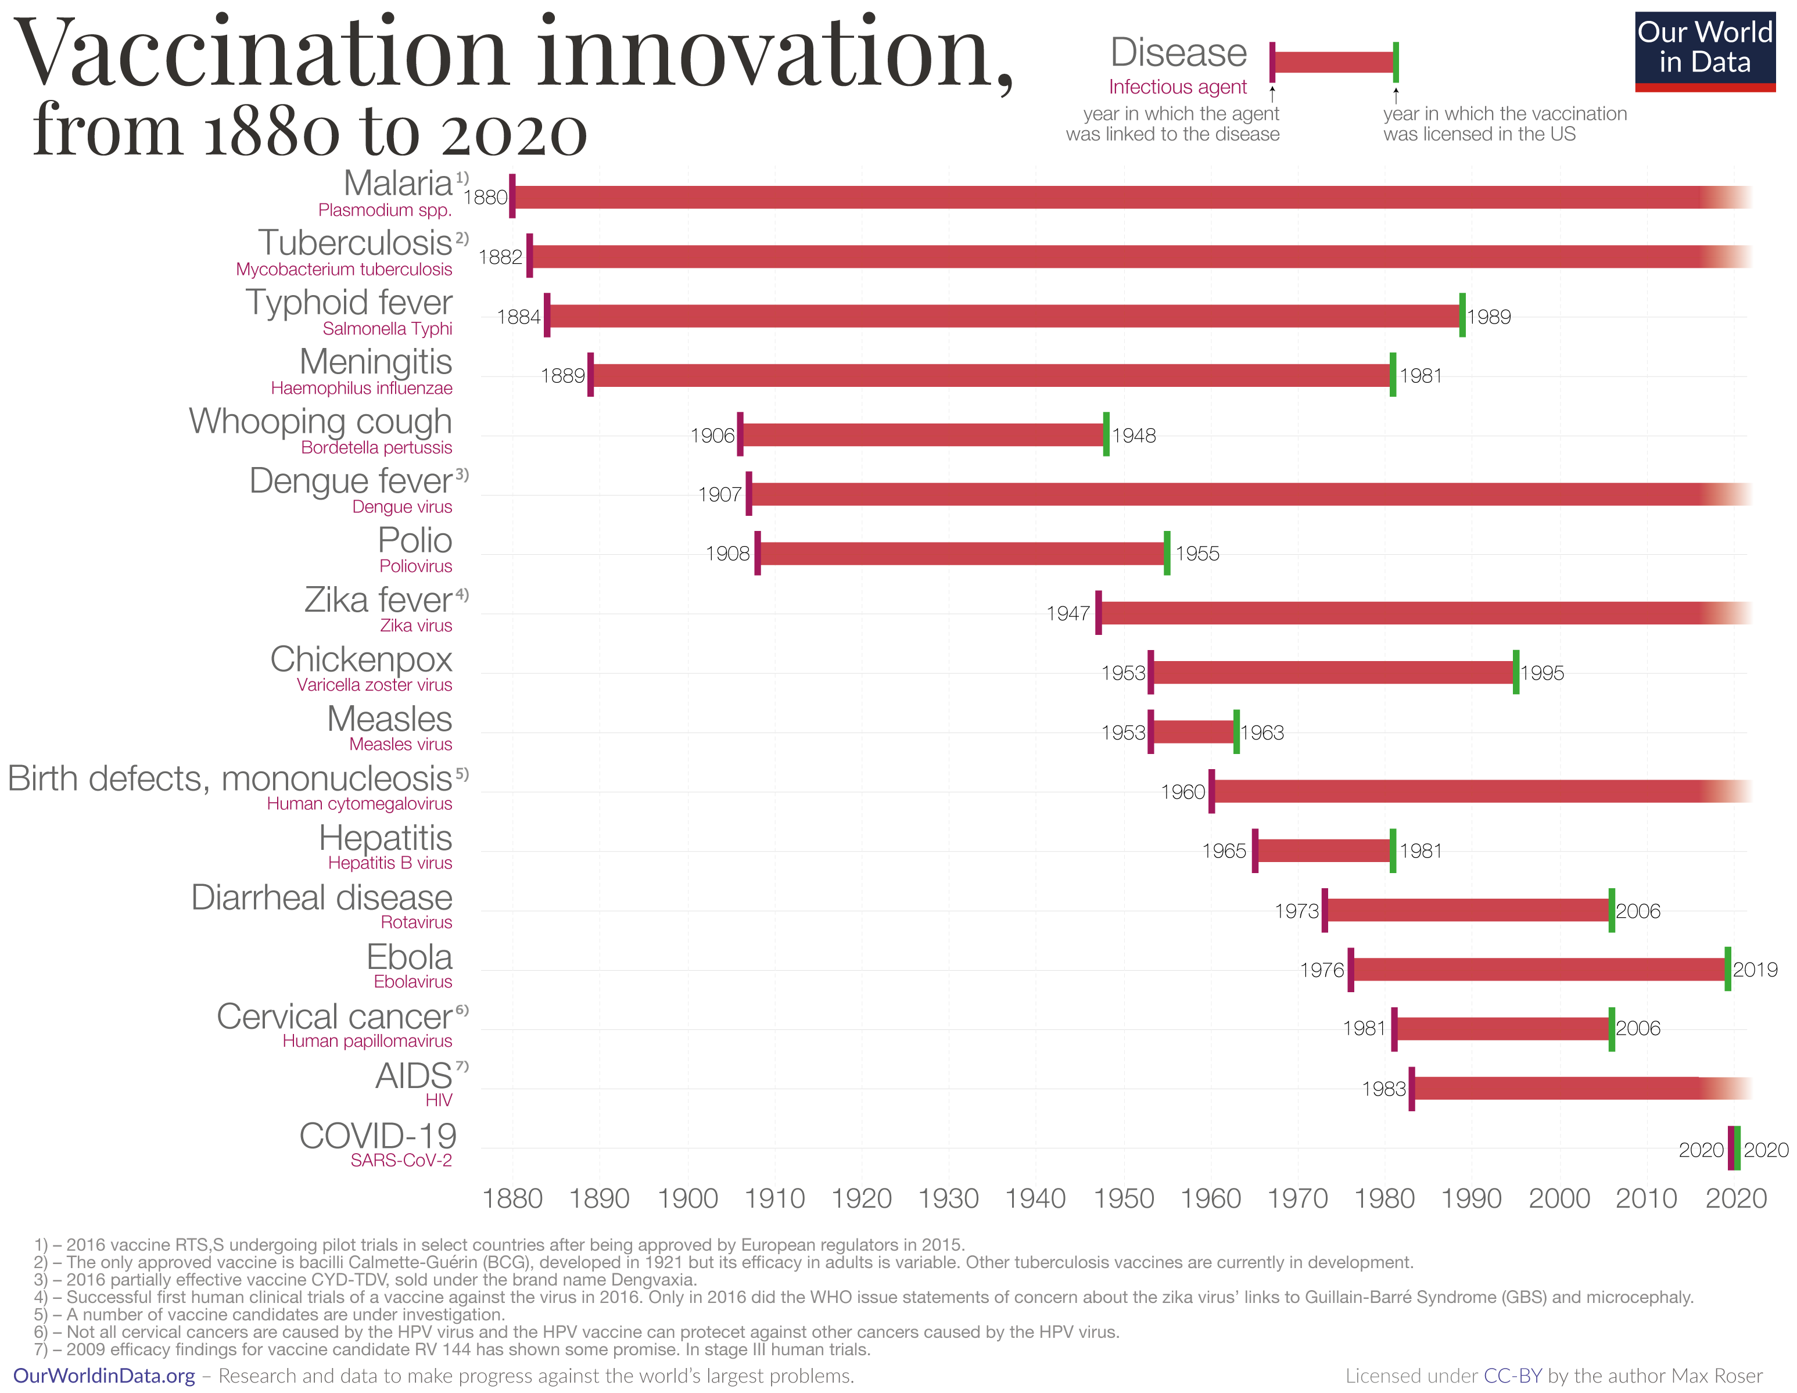
The pace of vaccine development has accelerated drastically

Slide 9
But we still lack vaccines for several important diseases.

Slide 10
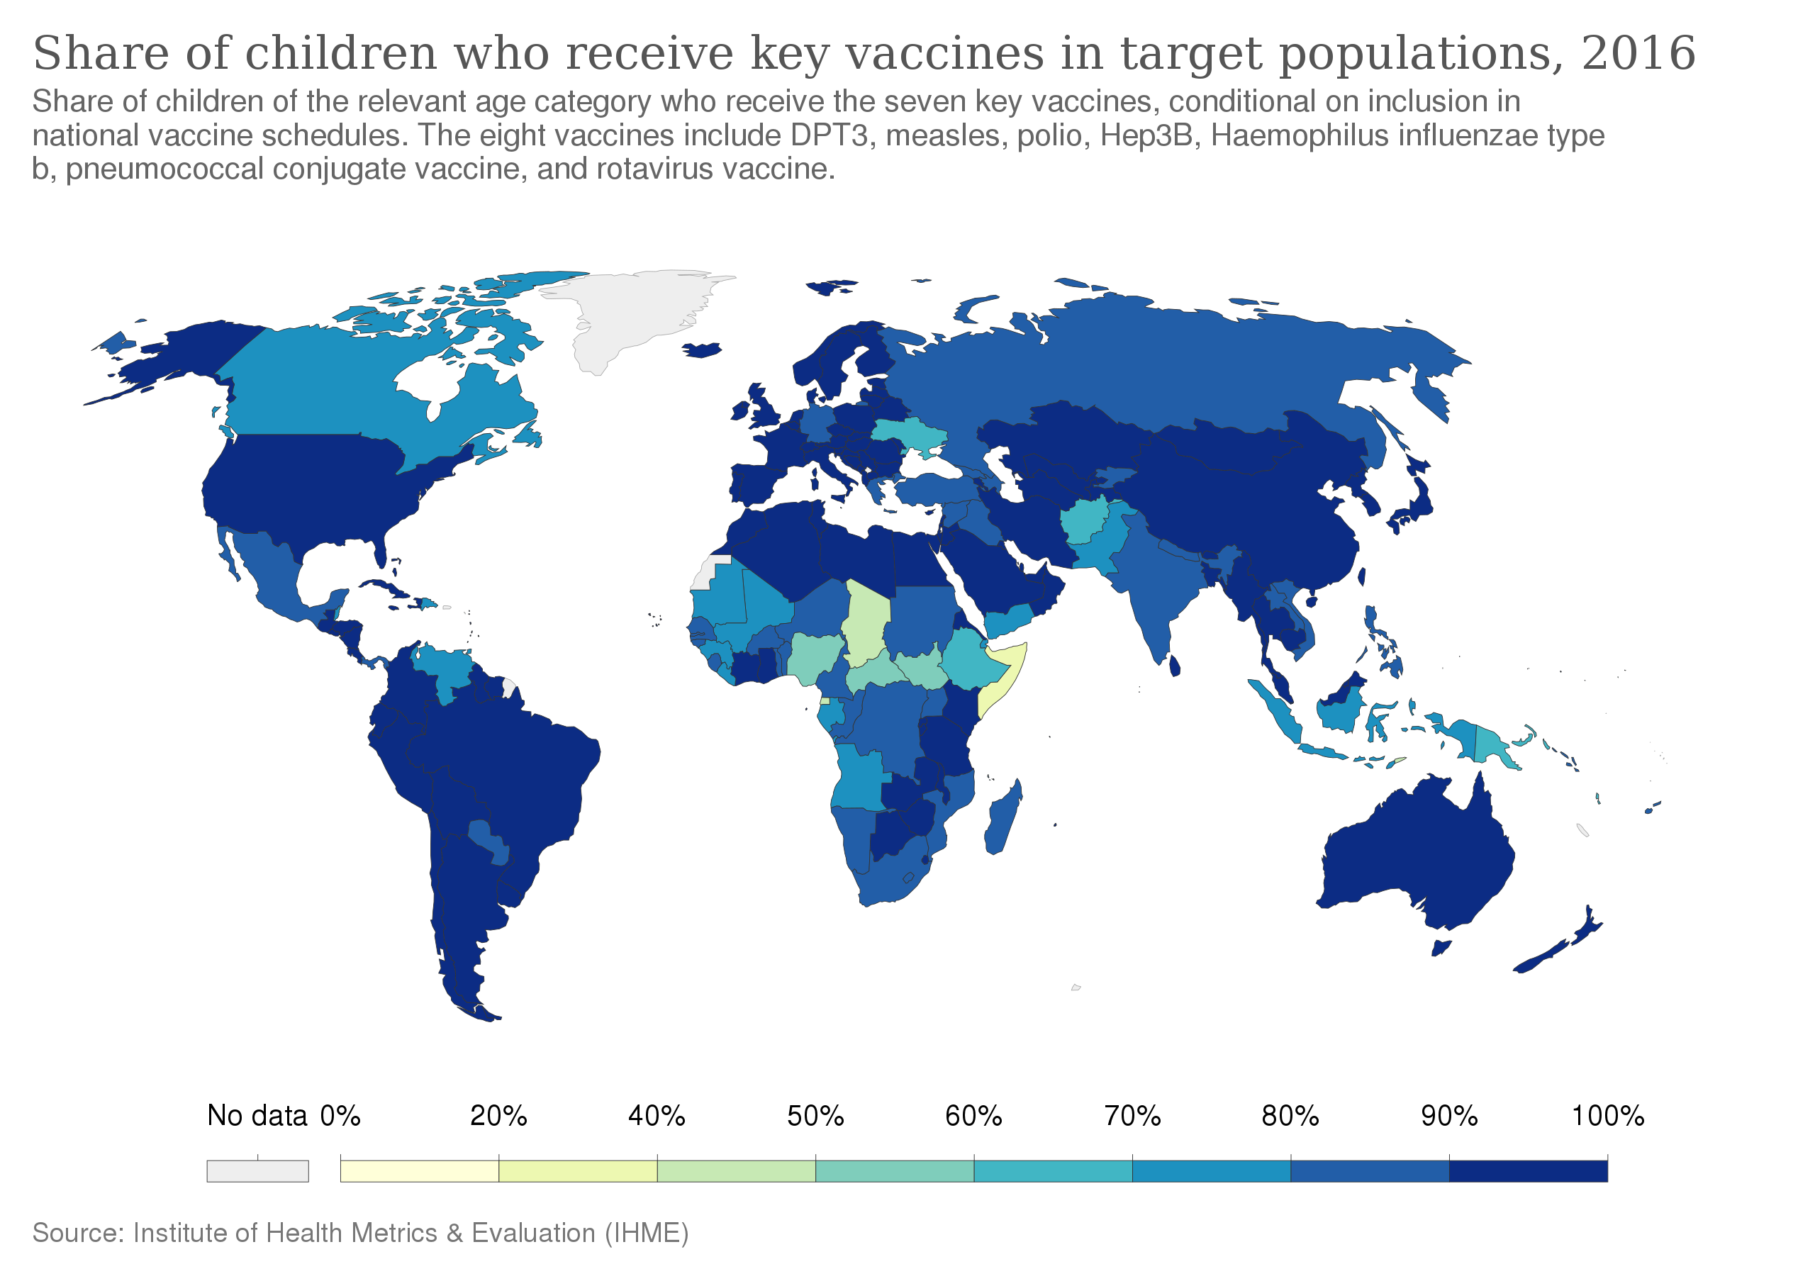

Slide 11
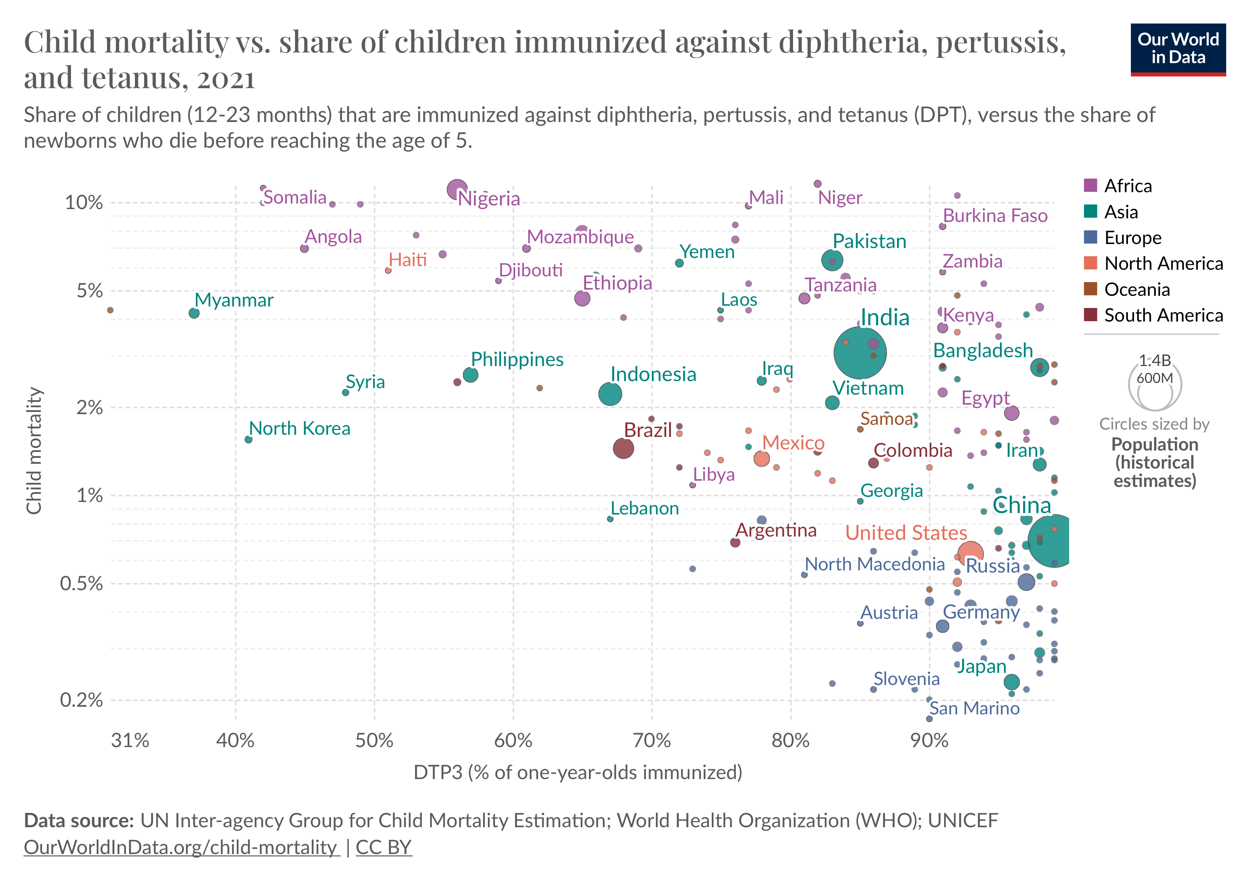

Slide 12
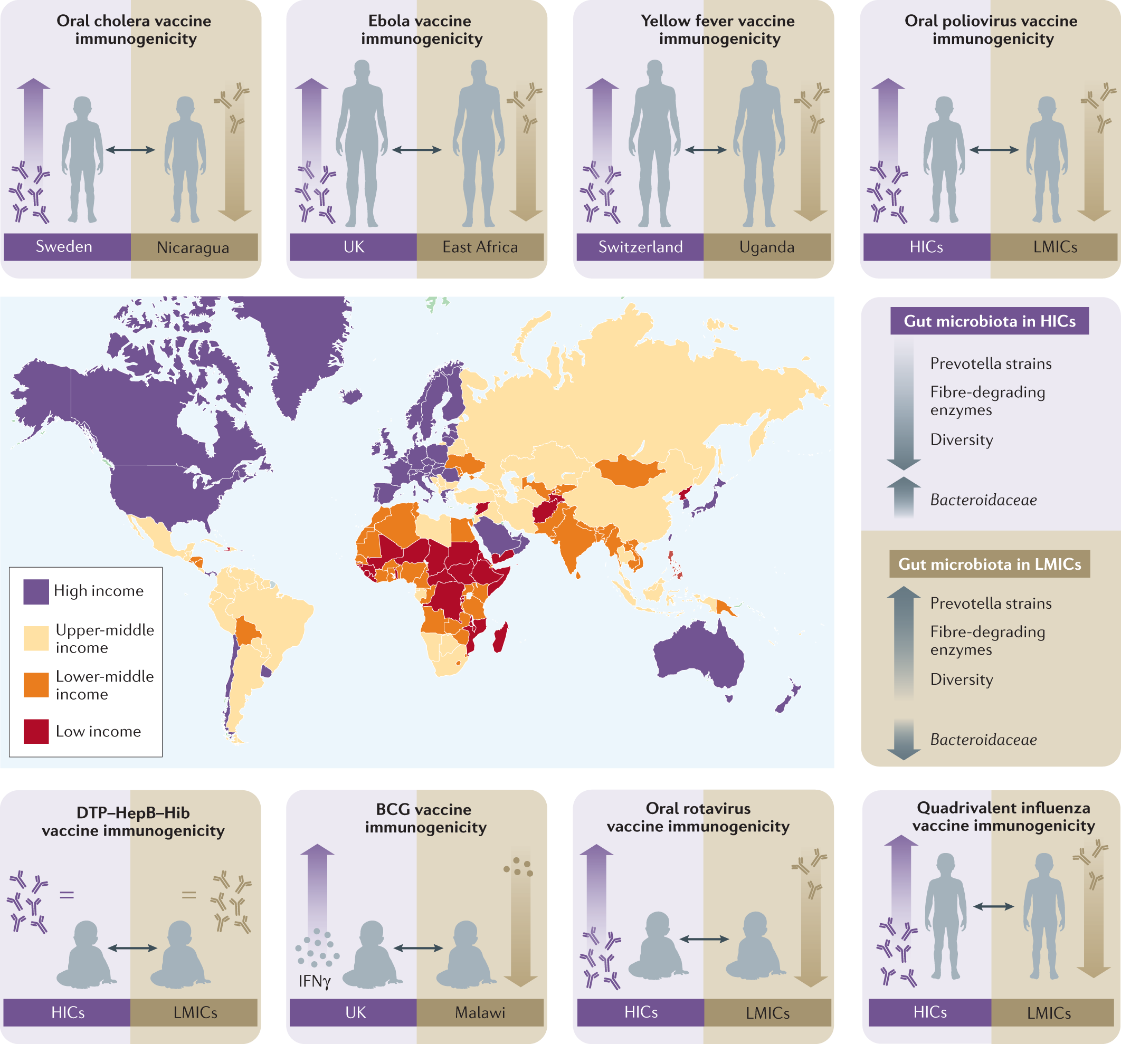
Nutrition and immunity
Nutrients known to be critical for the growth and function of immune cells:
Vitamin C
Vitamin D
Zinc
Selenium
Iron
Protein
Lynn et al 2021. Nature Reviews Immunology.

Slide 13
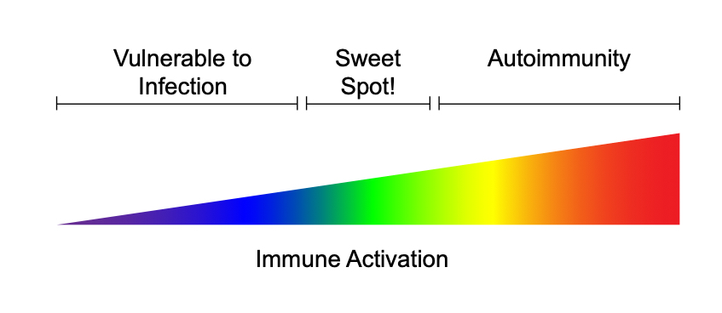
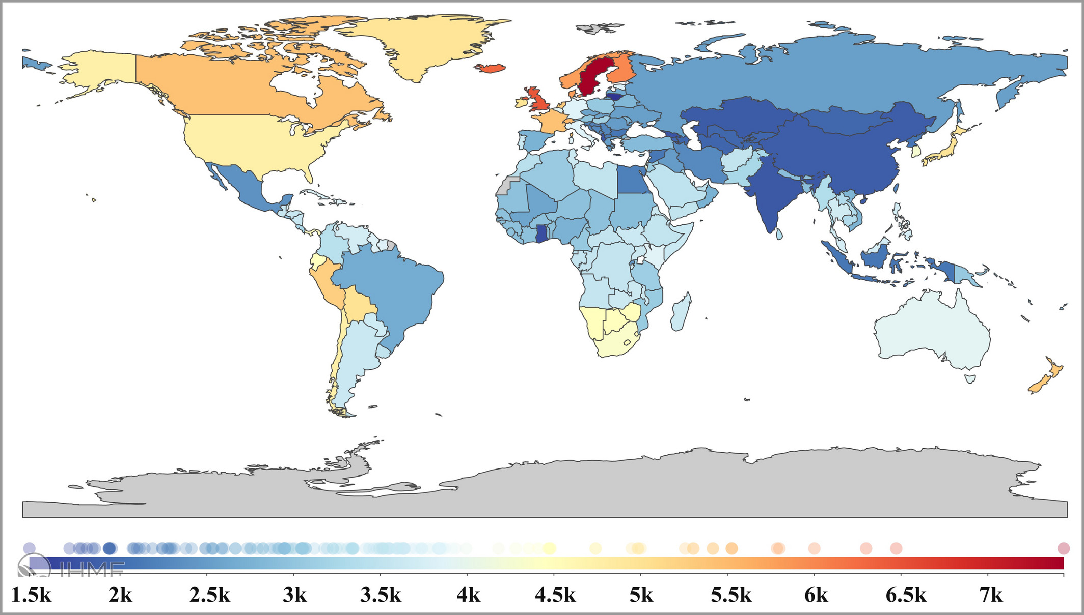
The flip side of robust immunity
Global Burden of Atopic Dermatitis
Laughter et al 2020. BMD.

Slide 14
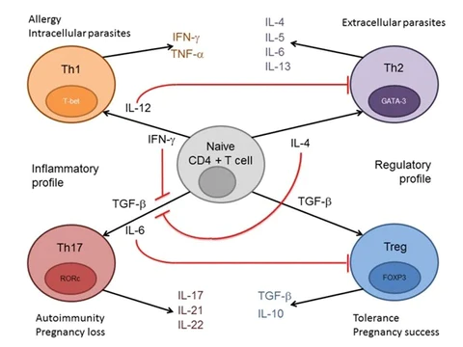
Th1 vs Th2 Immunity

Slide 15
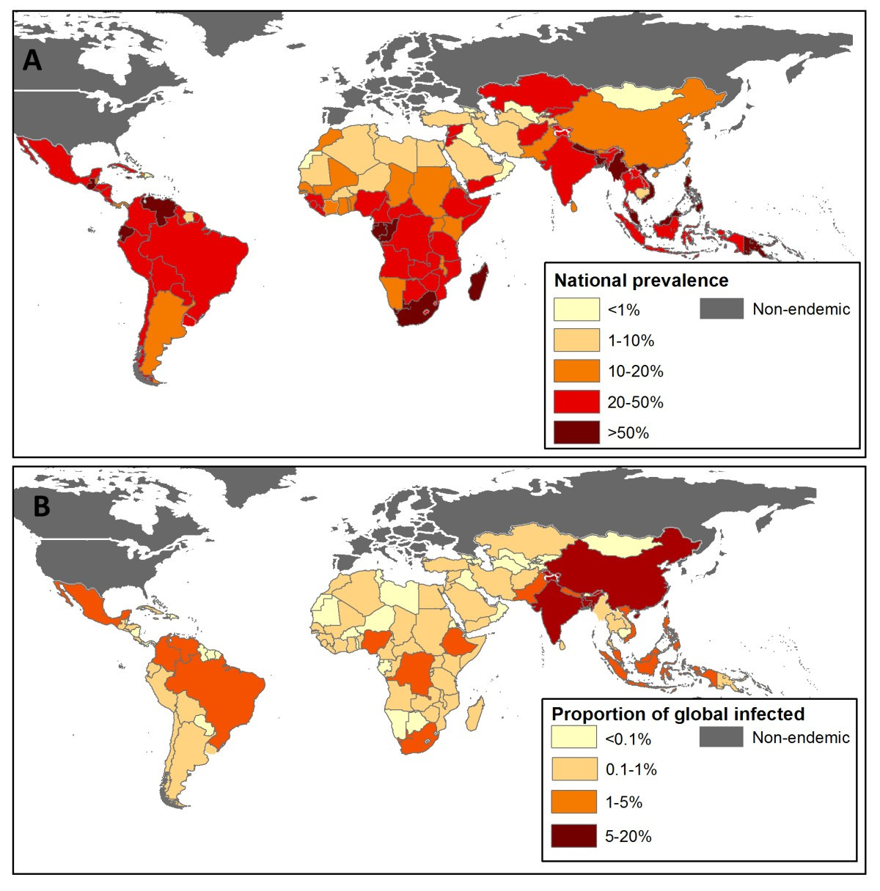
Global burden of soil transmitted helminth infections
Pullan et al. 2014. Parasites and Vectors.

Slide 16
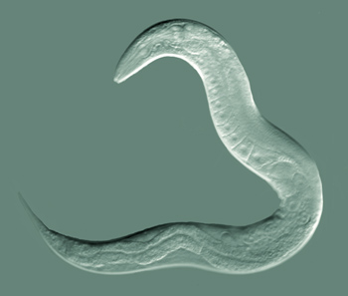
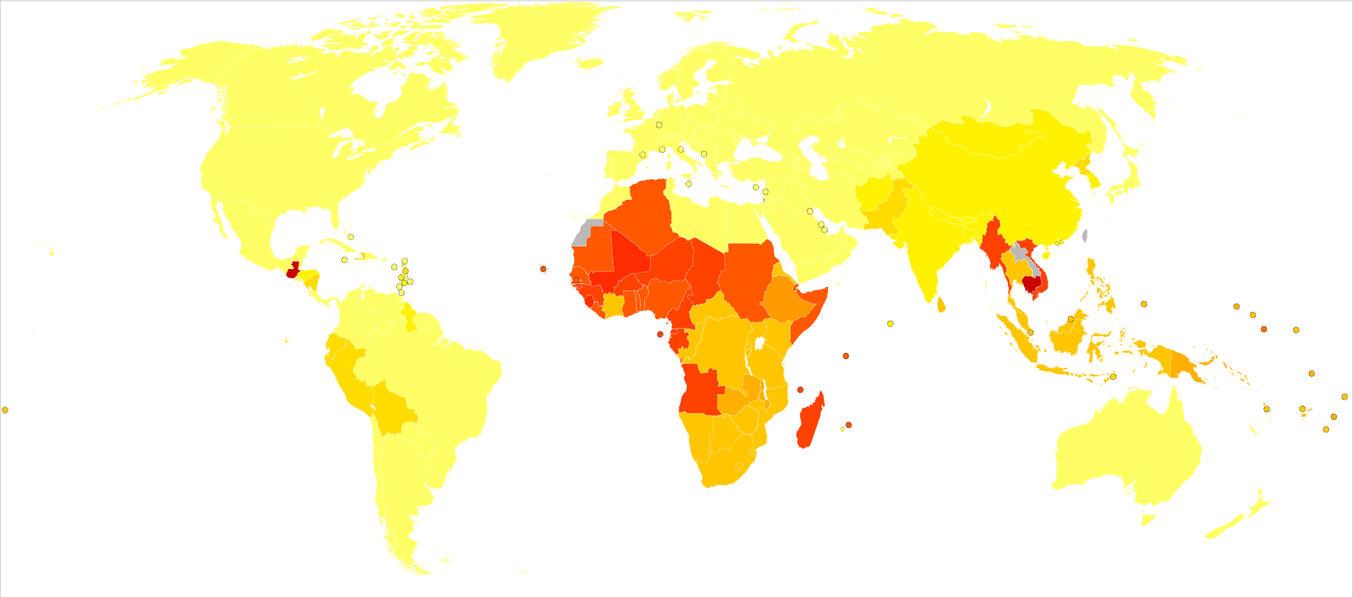
Helminths (parasitic worms)
Macroparasites, most soil-transmitted, infect GI tract
Not necessarily phylogenetically related
4 major phyla:
Annelida (ringed or segmented worms)
Platyhelminthes (flatworms)
Cestodes (tapeworms)
Trematodes (flukes and blood flukes = schistosomes)
Nematoda (roundworms)
Ascaris (largely commensal)
Hookworm (pathogenic)
Filarias (pathogenic)
Pinworm(largely commensal)
Whipworm (pathogenic)
Acanthocephala (thorny-headed worms)
Helminths infect up to 50% of the global human population, though burden is concentrated in LMICs

Slide 17
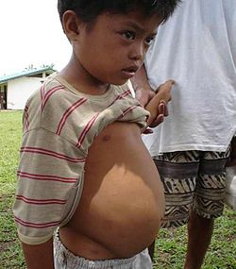
Schistosomiasis
Snail fever, bilharzia, Katayama fever
First infection characterized by rash as cercariae migrate into the body
Later can be very painful as adult worms migrate through muscle tissue (can take years). Also can be inflammatory reactions as adults lay eggs. Adult schistosomes undergo sexual reproduction in the human host.
Intestinal schistosomiasis occurs when eggs become lodged in intestinal wall, leading to blood loss, bloody stool, colon obstruction, resulting in abdominal distention
In 2010, approximately 238 million people were infected with schistosomiasis, 85% in Africa
Causes between 12-200,000 deaths annually, making it the most deadly of the neglected tropical diseases (contrast with HIV/AIDS, TB, malaria)

Slide 18
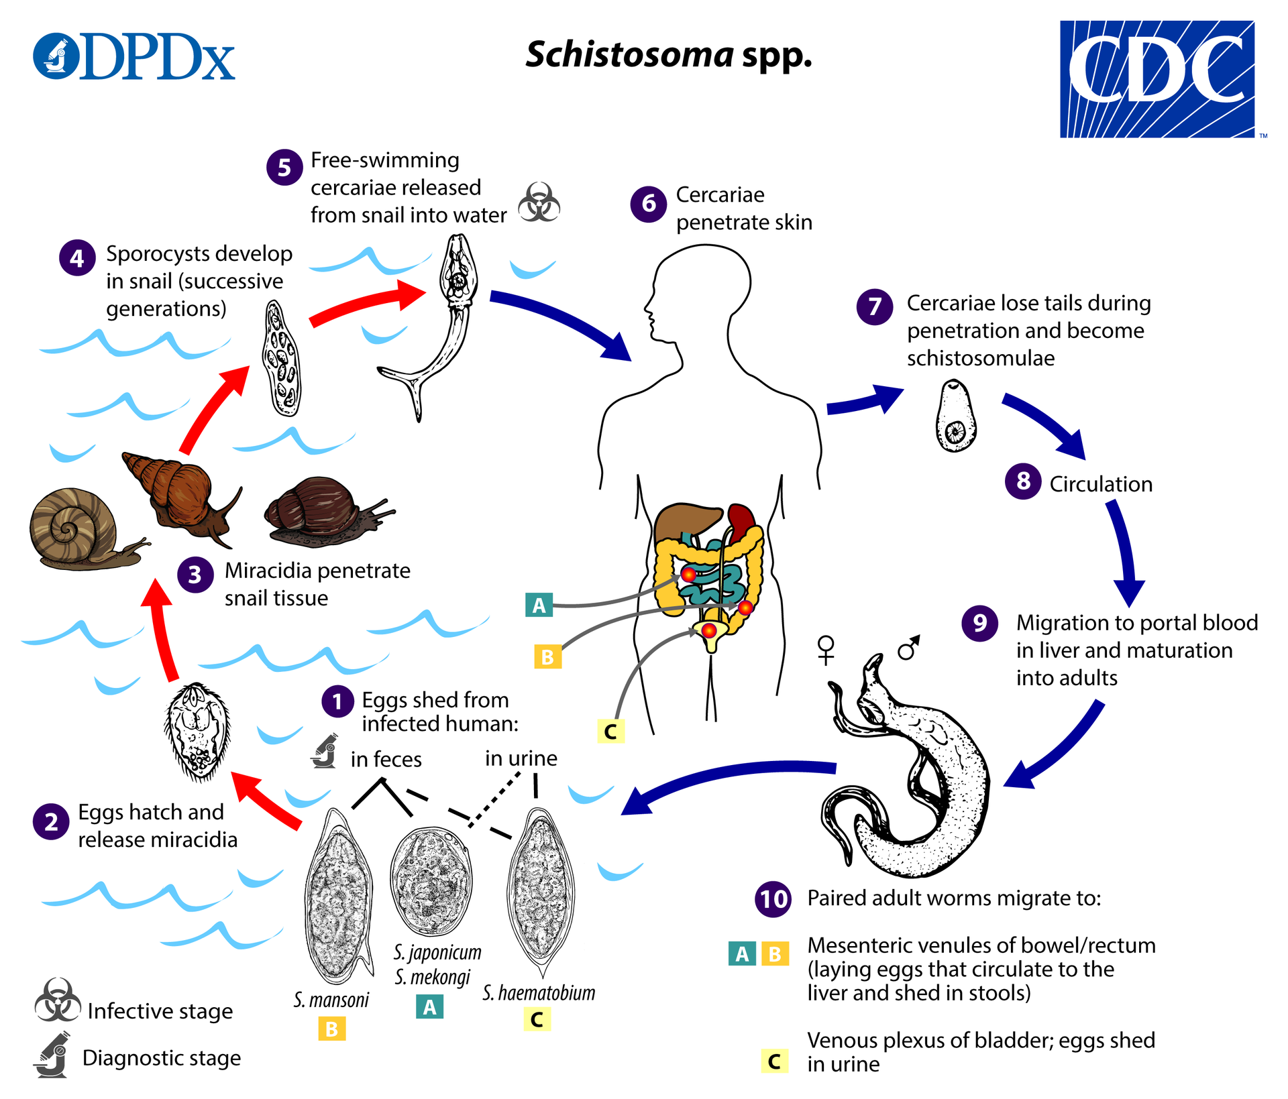
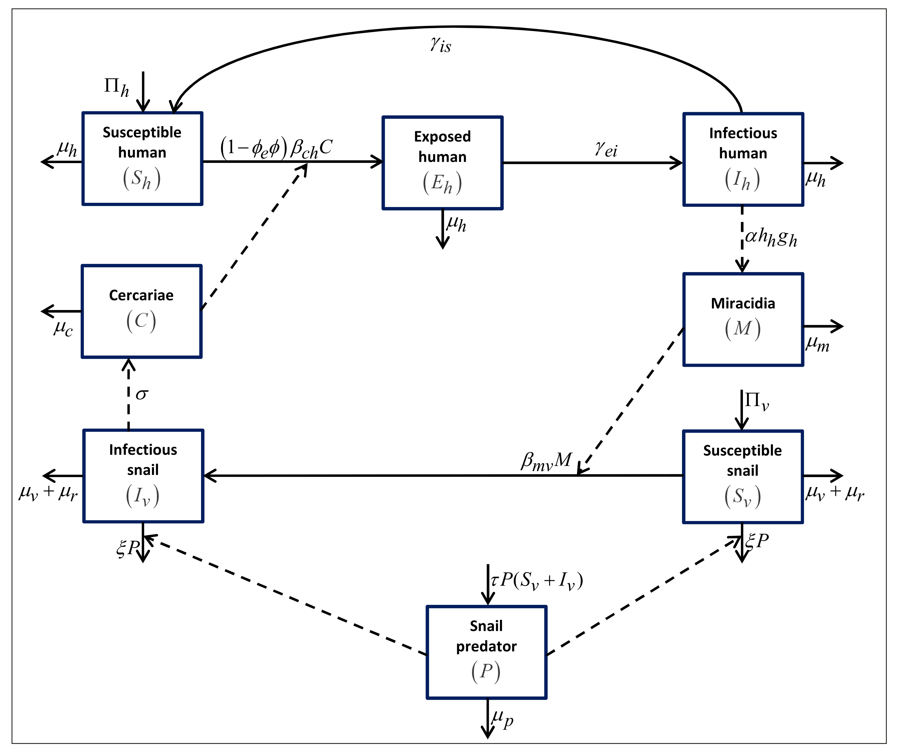
Modeling schistosomiasis
Nur et al. 2021. Mathematics.

Slide 19
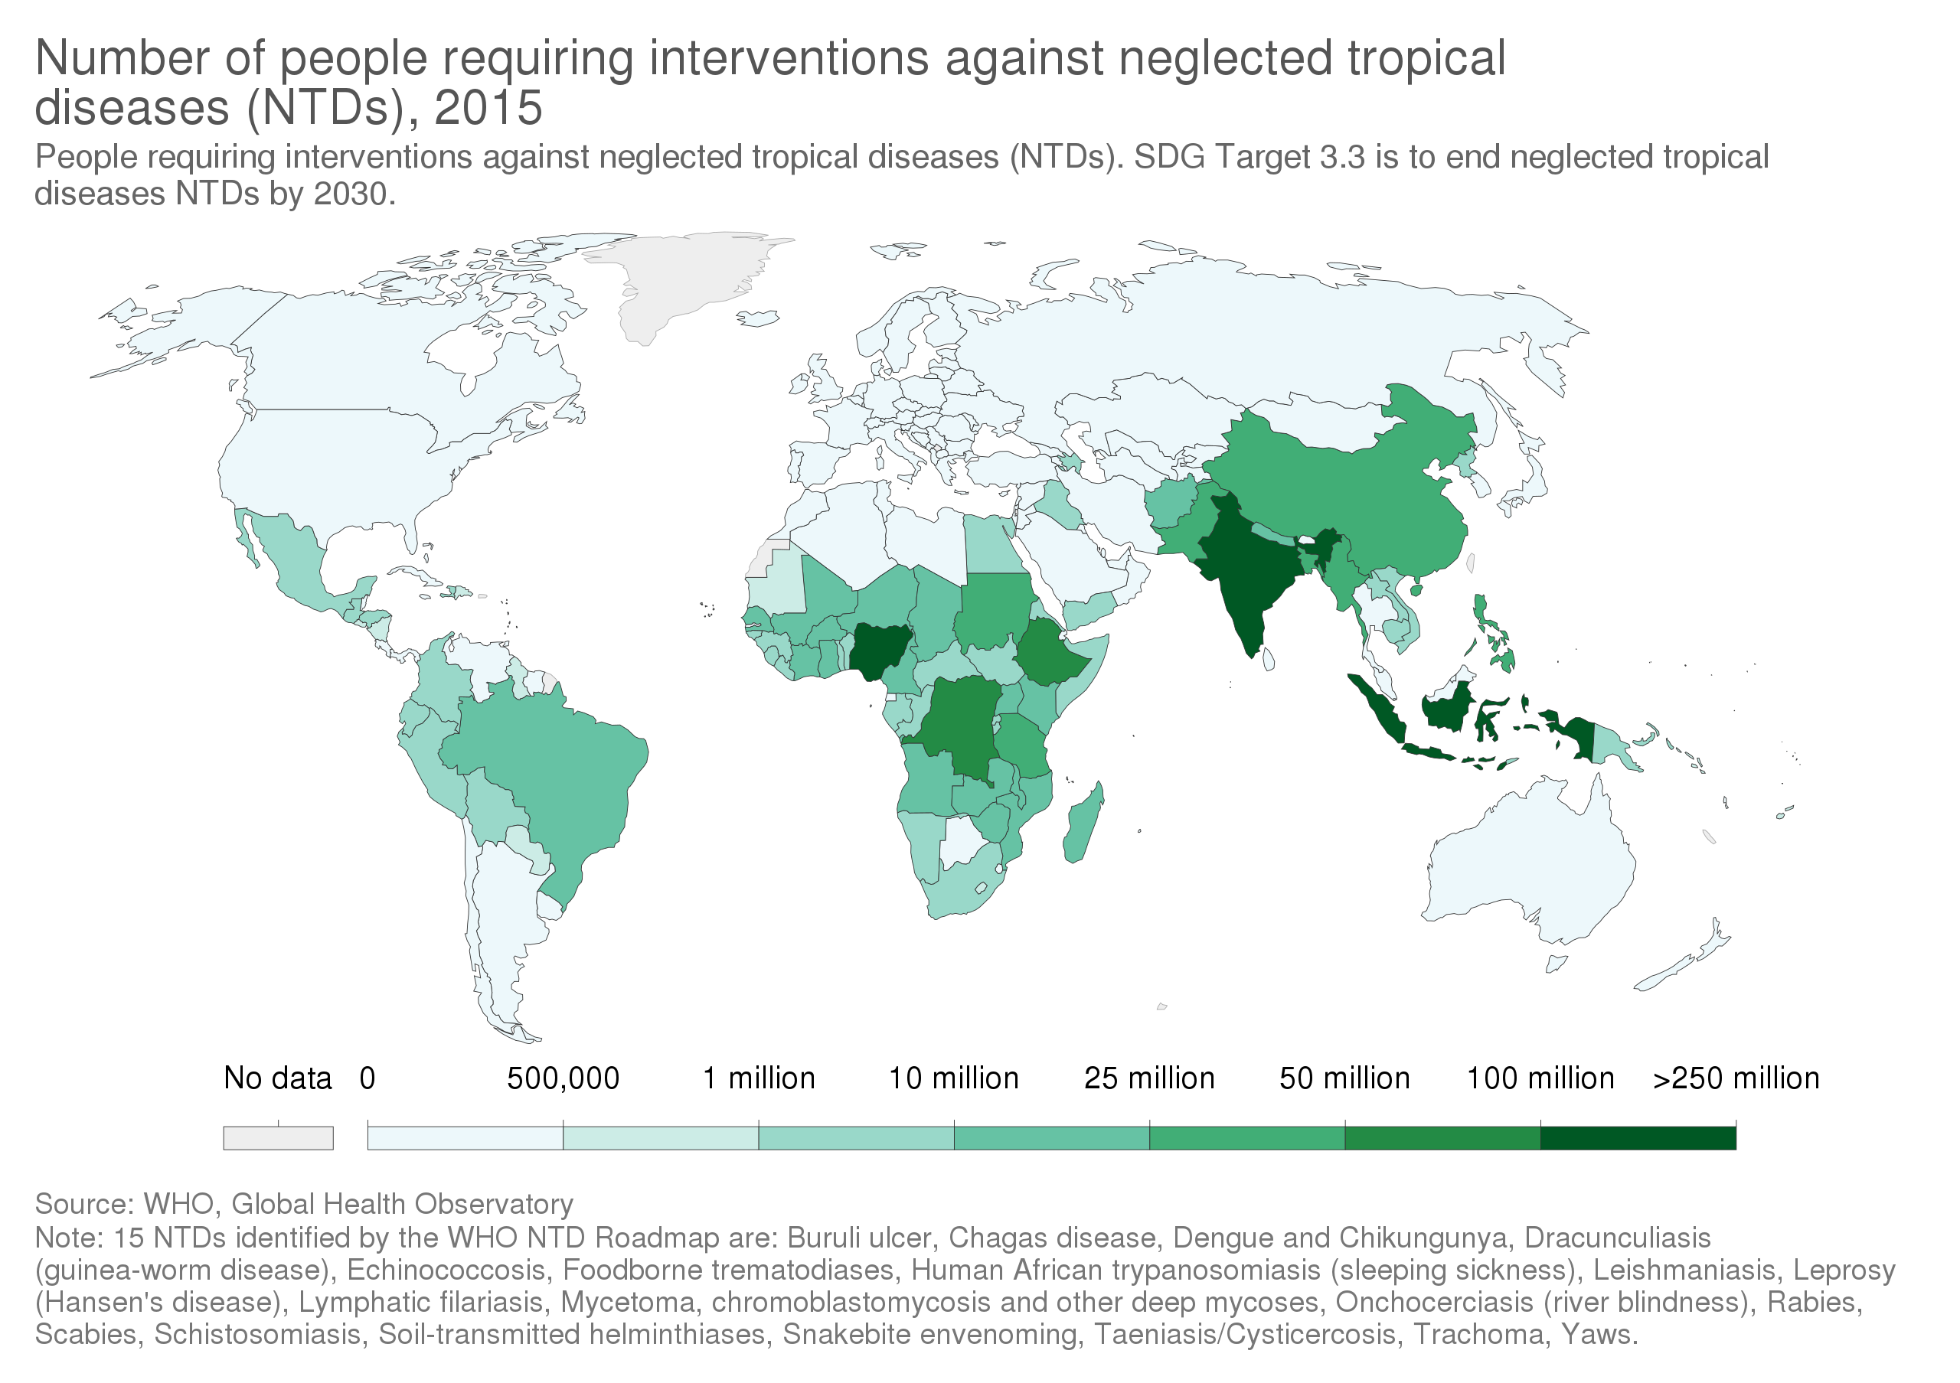
Global Burden of NTDs

Slide 20
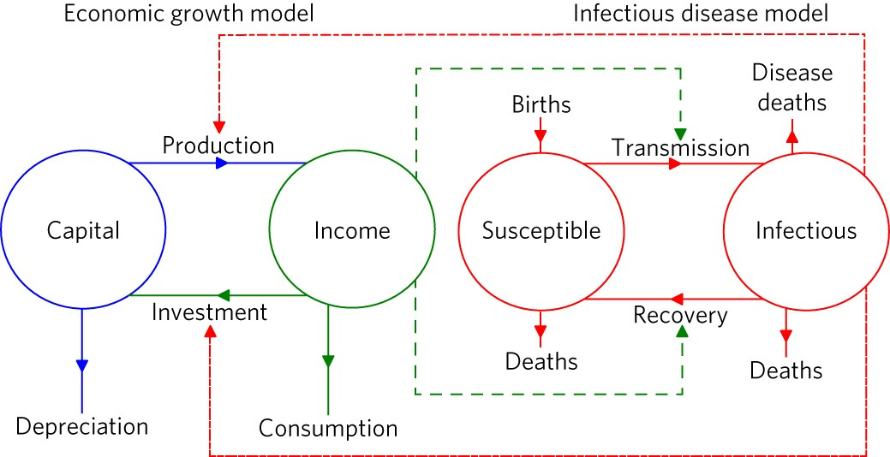
Poverty trap models of coupled social-ecological systems
Ngonghala et al 2017. Nature Ecology & Evolution.

Slide 21

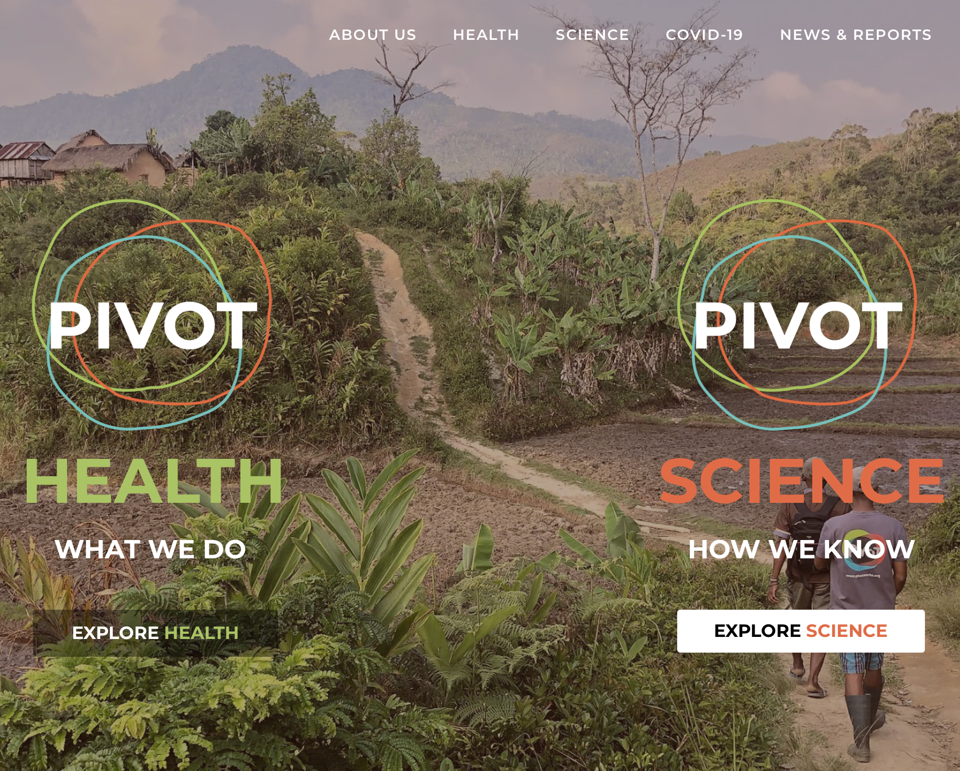
Breaking cycles of poverty and disease
pivotworks.org

